Slide 1
Board |  | Microcontroller
Brand | Model | Brand | Model | Core | Clock | Width | FPU | RAM
Arduino | Uno | Atmel | MEGA328P | AVR | 16 MHz | 8-bit | No | 2 KB
Arduino | M0 PRO | Atmel | SAMD21G18 | ARM Cortex-M0+ | 48 MHz | 32-bit | No | 32 KB
LeafLabs | Maple | STM | STM32F103 | ARM Cortex-M3 | 72 MHz | 32-bit | No | 20 KB
Arduino | Due | Atmel | SAM3X8E | ARM Cortex-M3 | 84 MHz | 32-bit | No | 96 KB
PJRC | Teensy 3.2 | NXP | MK20DX256 | ARM Cortex-M4 | 96 MHz | 32-bit | No | 64 KB
NXP | FRDM-K66F | NXP | MK66FN2M0 | ARM Cortex-M4F | 180 MHz | 32-bit | Yes | 256 KB

Slide 2
FIR Performance (Naïve C)
Inputs |  | FIR Filters Completed per Second (Bigger is Better)
Type | N of FIR | Arduino Uno | Arduino M0 | Maple | Arduino Due | Teensy 3.2 | FRDM-K66F
Int32 | 16 | 7,752 | 92,851 | 180,180 | 154,083 | 502,513 | 833,333
Int32 | 32 | 3,937 | 48,100 | 93,809 | 79,365 | 261,780 | 416,667
Int32 | 64 | 1,988 | 24,492 | 47,824 | 40,323 | 133,333 | 212,766
Int32 | 128 | 1,000 | 12,359 | 24,160 | 20,321 | 67,340 | 107,527
Int32 | 256 |  | 6,209 | 12,142 | 10,199 | 33,841 | 54,054
Type | N of FIR | Arduino Uno | Arduino M0 | Maple | Arduino Due | Teensy 3.2 | FRDM-K66F
Float32 | 16 | 3,215 | 8,709 | 25,387 | 28,019 | 32,755 | 769,231
Float32 | 32 | 1,608 | 4,416 | 12,888 | 13,959 | 16,126 | 370,370
Float32 | 64 | 787 | 2,240 | 6,500 | 6,972 | 8,007 | 200,000
Float32 | 128 | 397 | 1,120 | 3,266 | 3,485 | 3,991 | 100,000
Float32 | 256 |  | 561 | 1,637 | 1,743 | 1,993 | 50,251

Slide 3
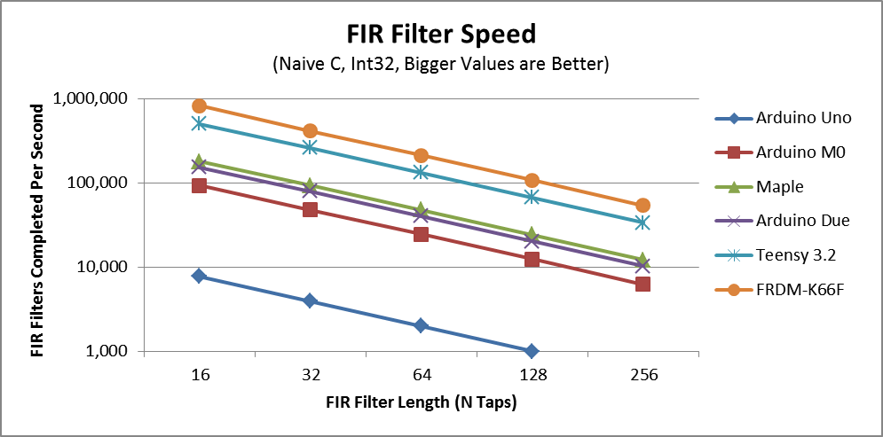

Slide 4
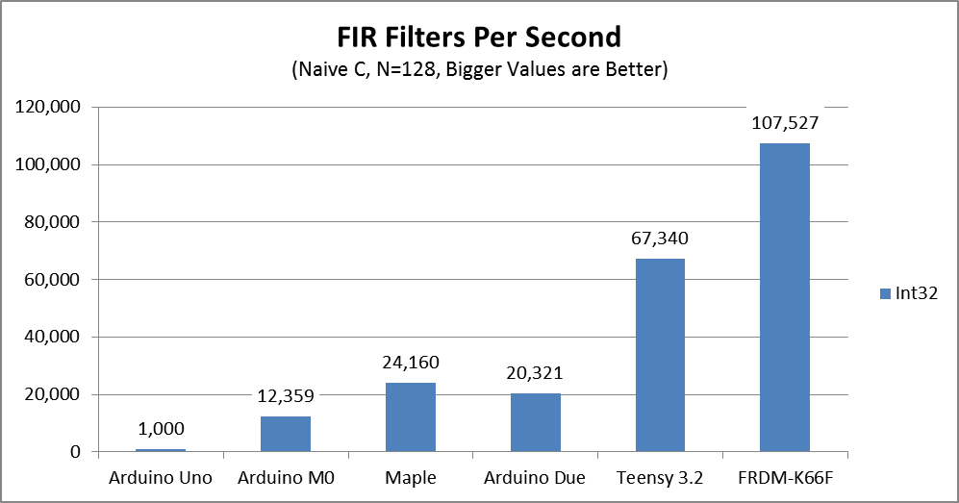

Slide 5
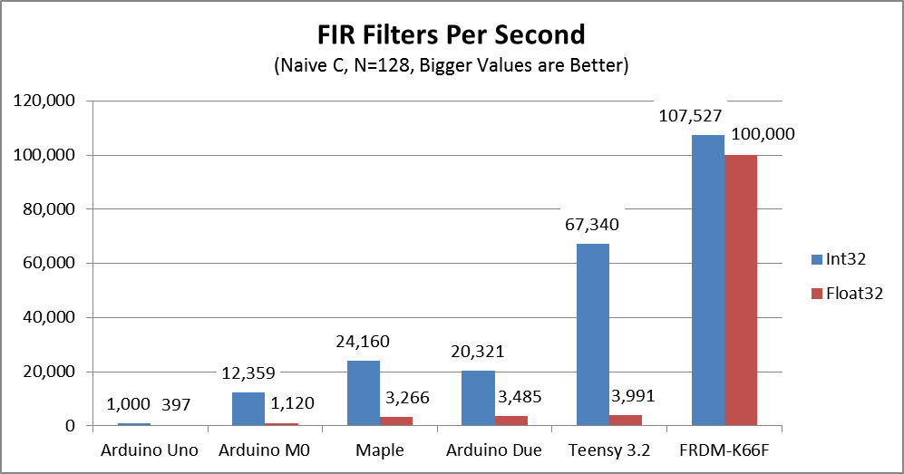

Slide 6
FIR Performance (Naïve C)
Inputs |  | Max Sample Rate (Hz) for FIR Filter of the Given Size (Bigger is Better)
Type | N of FIR | Arduino Uno | Arduino M0 | Maple | Arduino Due | Teensy 3.2 | FRDM-K66F
Int32 | 176 | 727 | 8,989 | 17,571 | 14,779 | 48,975 | 78,201
Float32 | 176 | 288 | 815 | 2,375 | 2,535 | 2,902 | 72,727

Slide 7
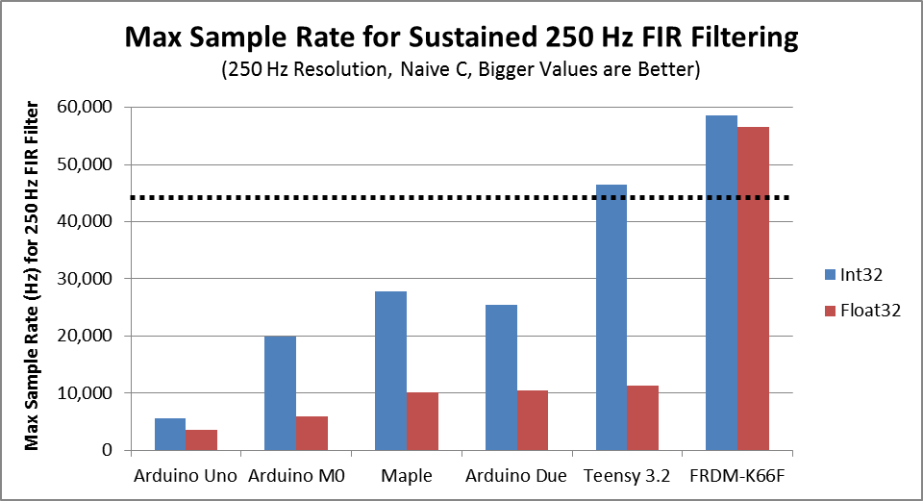
FIR Performance (Naïve C)
Inputs |  | Max Sample Rate (Hz) with FIR at Given Resolution (Bigger is Better)
Type | Res (Hz) | Arduino Uno | Arduino M0 | Maple | Arduino Due | Teensy 3.2 | FRDM-K66F
Int32 | 250 | 5,657 | 19,887 | 27,805 | 25,500 | 46,421 | 58,659
Float32 | 250 | 3,562 | 5,987 | 10,223 | 10,561 | 11,301 | 56,569

Slide 8
Old

Slide 9
FIR Performance (Naïve C)
Inputs |  | Time to Complete FIR (microseconds, smaller is better)
Type | N of FIR | Arduino Uno | Arduino M0 | Maple | Arduino Due | Teensy 3.2 | FRDM-K66F
Int16 | 16 | 41.0 | 9.1 | 6.5 | 6.5 | 2.0 | 1.4
Int16 | 32 | 79.0 | 17.5 | 12.5 | 12.6 | 3.8 | 2.8
Int16 | 64 | 155.0 | 34.2 | 24.5 | 24.8 | 7.5 | 5.4
Int16 | 128 | 308.0 | 67.6 | 48.5 | 49.2 | 14.9 | 10.7
Int16 | 256 | 612.0 | 134.4 | 96.6 | 98.1 | 29.6 | 21.3
Type | N of FIR | Arduino Uno | Arduino M0 | Maple | Arduino Due | Teensy 3.2 | FRDM-K66F
Int32 | 16 | 129.0 | 10.8 | 5.6 | 6.5 | 2.0 | 1.2
Int32 | 32 | 254.0 | 20.8 | 10.7 | 12.6 | 3.8 | 2.4
Int32 | 64 | 503.0 | 40.8 | 20.9 | 24.8 | 7.5 | 4.7
Int32 | 128 | 1000.0 | 80.9 | 41.4 | 49.2 | 14.9 | 9.3
Int32 | 256 |  | 161.1 | 82.4 | 98.1 | 29.6 | 18.5
Type | N of FIR | Arduino Uno | Arduino M0 | Maple | Arduino Due | Teensy 3.2 | FRDM-K66F
Float32 | 16 | 311.0 | 114.8 | 39.4 | 35.7 | 30.5 | 1.3
Float32 | 32 | 622.0 | 226.5 | 77.6 | 71.6 | 62.0 | 2.7
Float32 | 64 | 1270.0 | 446.5 | 153.8 | 143.4 | 124.9 | 5.0
Float32 | 128 | 2522.0 | 892.7 | 306.2 | 286.9 | 250.6 | 10.0
Float32 | 256 |  | 1783.7 | 610.8 | 573.8 | 501.9 | 19.9

Slide 10
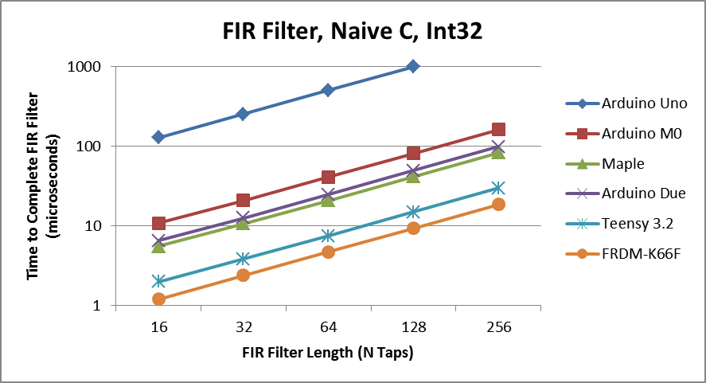

Slide 11
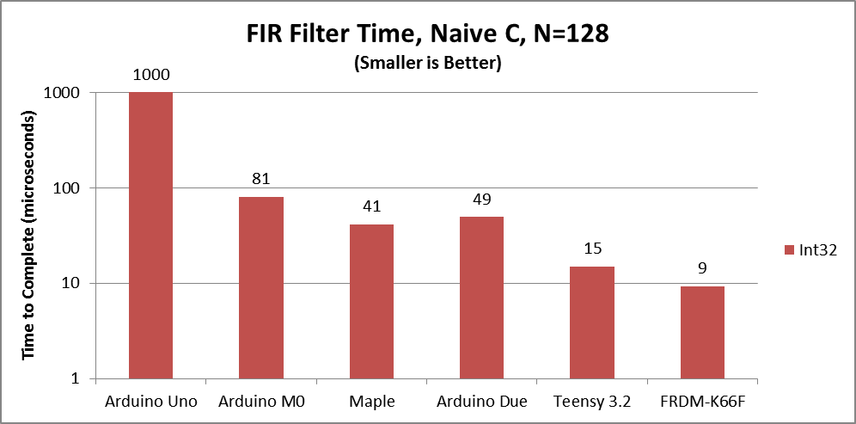

Slide 12
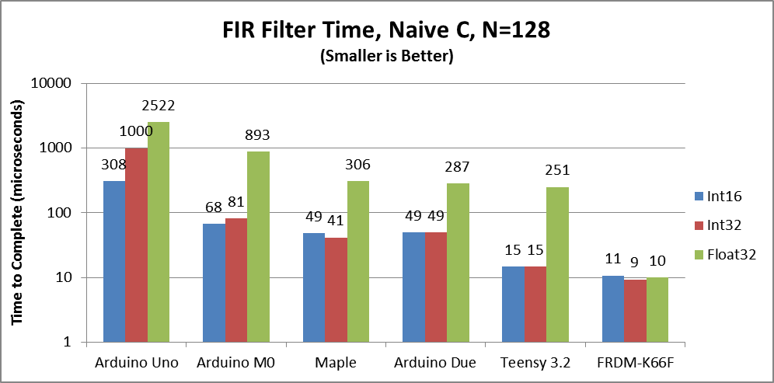

Slide 13
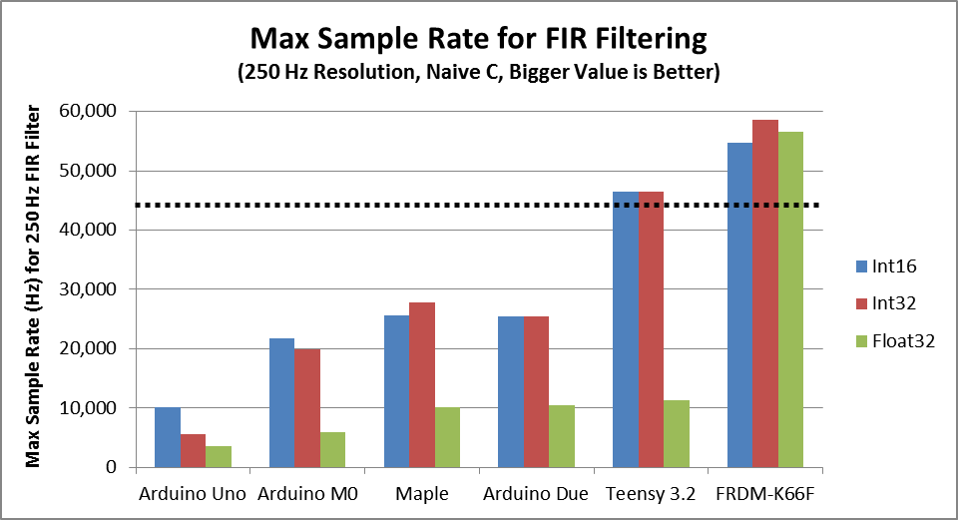
FIR Performance (Naïve C)
Inputs |  | Max Sample Rate (Hz) with FIR at Given Resolution (Bigger is Better)
Type | Res (Hz) | Arduino Uno | Arduino M0 | Maple | Arduino Due | Teensy 3.2 | FRDM-K66F
Int16 | 250 | 10,193 | 21,765 | 25,679 | 25,500 | 46,421 | 54,687
Int32 | 250 | 5,657 | 19,887 | 27,805 | 25,500 | 46,421 | 58,659
Float32 | 250 | 3,562 | 5,987 | 10,223 | 10,561 | 11,301 | 56,569

